Slide 1
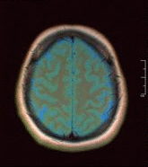
Using U-Net network for efficient brain tumor segmentation in MRI image
Student: kaveh karimadini
Teacher: Dr Zarafshan

Slide 2
Introduction to Brain Tumor Segmentation
Tumors are abnormal tissue growths in the human anatomy, which can be malignant or benign.
Manual identification of tumors is challenging, necessitating the need for intelligent systems for automatic detection.
Advancements in medical technologies have impacted diagnostics and predictive analysis of diseases, including brain tumor segmentation using MRI images.

Slide 3
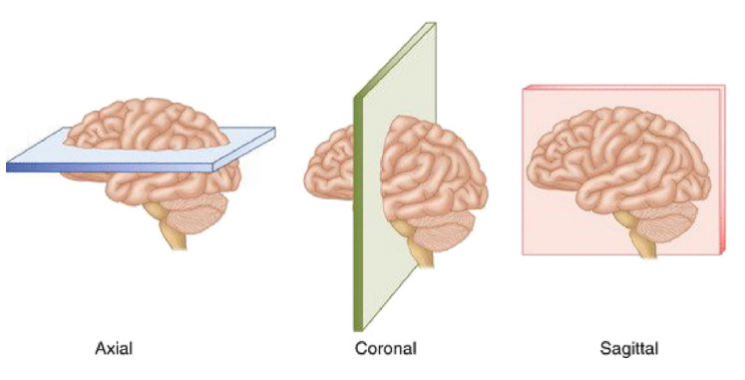
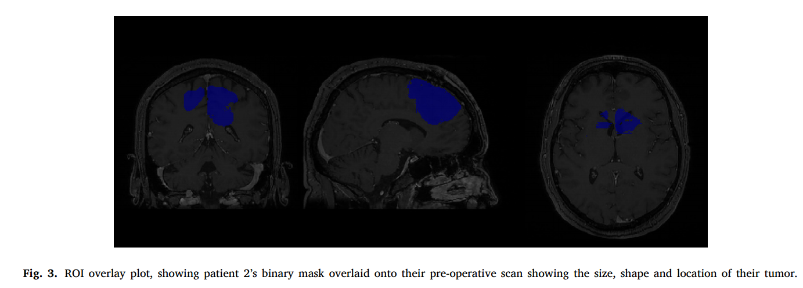
U-Net for Brain Tumor Segmentation
U-Net is a lightweight implementation proposed for real-time segmentation of MRI scans.
It achieves a mean intersection-over-union (IoU) of 89% on the BITE dataset, outperforming standard benchmark algorithms.
Effective use of the three perspective planes for simplified brain tumor segmentation is demonstrated.
The need of lesser data is what makes this architecture astonishing.
no additional data augmentation step is required

Slide 4
Brain Tumor Segmentation Techniques
Image segmentation is crucial in medical imaging, with various algorithms proposed for brain tumor segmentation.
Techniques include thresholding, classifiers, clustering, and deep learning networks.

Slide 5
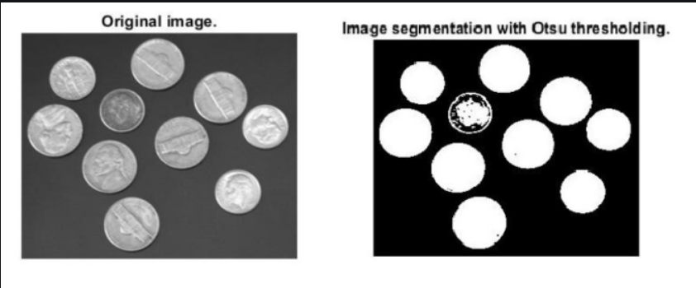
Thresholding
used to convert a gray-scaled or a red–green–blue (RGB) image into a binary image and use techniques like Otsu and global thresholding for medical image segmentation.
Otsu’s method and global thresholding have been used for medical image segmentation.

Slide 6
Classifiers
the classification decision are made from an existing dataset of annotated (or labeled) images
Classifiers, such as k-nearest neighbor and Hidden Markov Models, are used for image segmentation and feature learning.

Slide 7
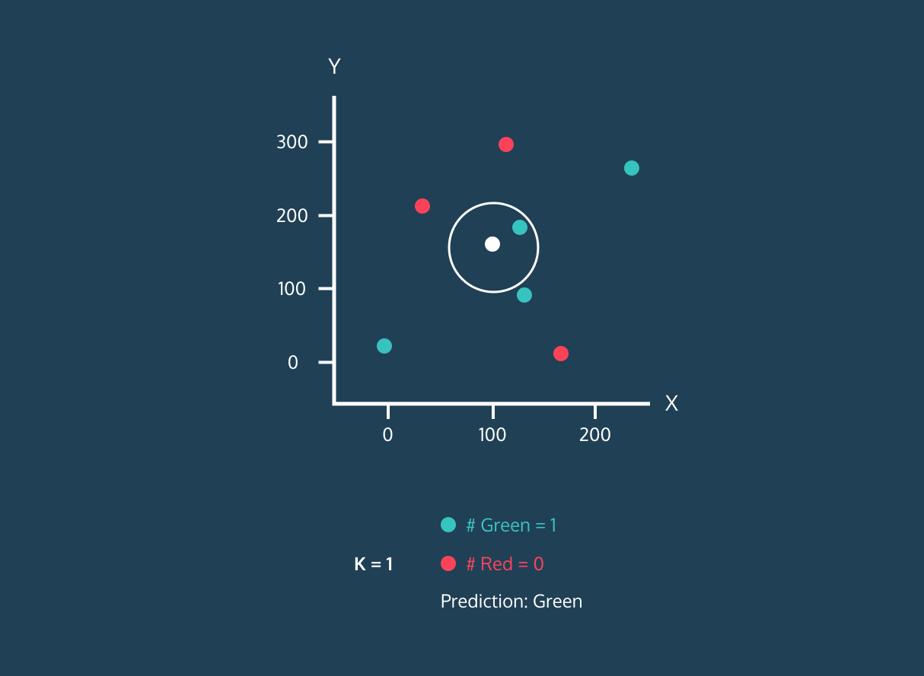
k-nearest neighbor
Features of each pixel are computed at first.
Then the pixels with high degree of similarity within these features, are merged together

Slide 8
Hidden Markov Models (HMM)
proven to perform significantly better than Support Vector Regression (SVR) models when used for brain tumor segmentation.

Slide 9
Clustering
Unsupervised learning algorithm meaning there is no target labeled dataset to learn the features from.
Essentially train themselves by identifying the possible underlying patterns
Clustering algorithms, an unsupervised learning technique, are used for image segmentation to identify underlying patterns like k-means and Fuzzy c-means (soft k-means)

Slide 10
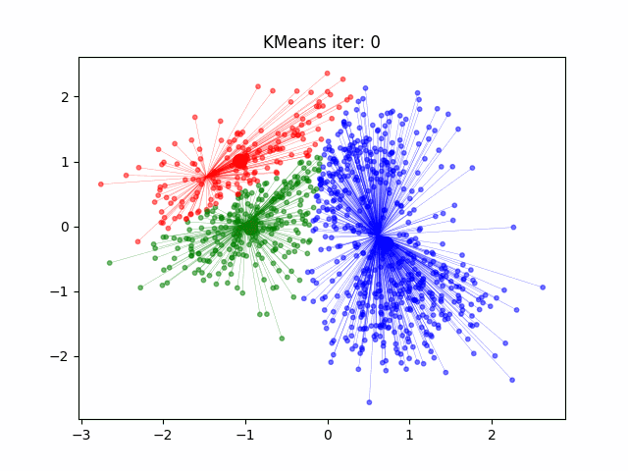
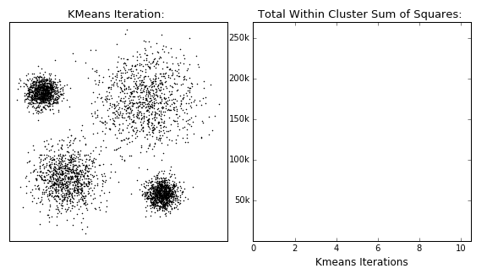
k-means
In image segmentation, it segments an area of interest from the background of an input image.
This method will partition the features of the dataset (pixels/voxels) into several clusters.
each feature will belong to a cluster with the closest mean.

Slide 11
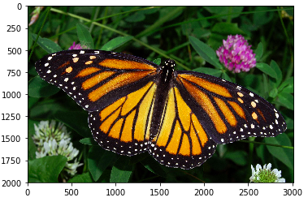
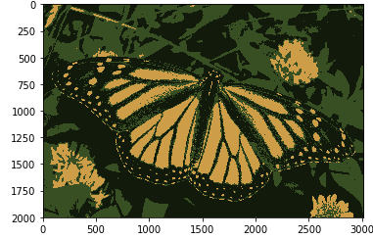
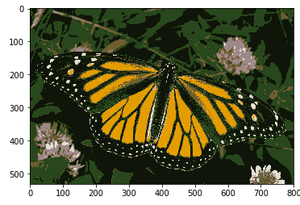
Output of k-means
Before
After(K=3)
After(K=6)

Slide 12
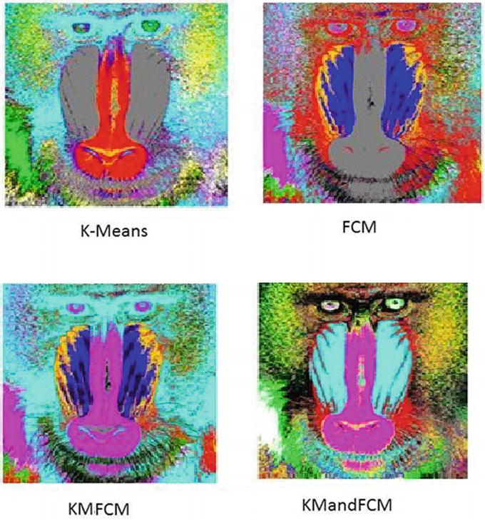
Fuzzy c-means (soft k-means)
A variation of k-means where each feature can belong to more than one cluster based on the degree of membership

Slide 13

Convolutional Neural Network (CNN)
A class of deep neural network which is prominently used for the analysis of two-dimensional imagery.
MRNet is one such system:
is primarily used to classify if a particular MRI image contains one of the three abnormalities that computes this via an output probability and uses logistic regression

Slide 14
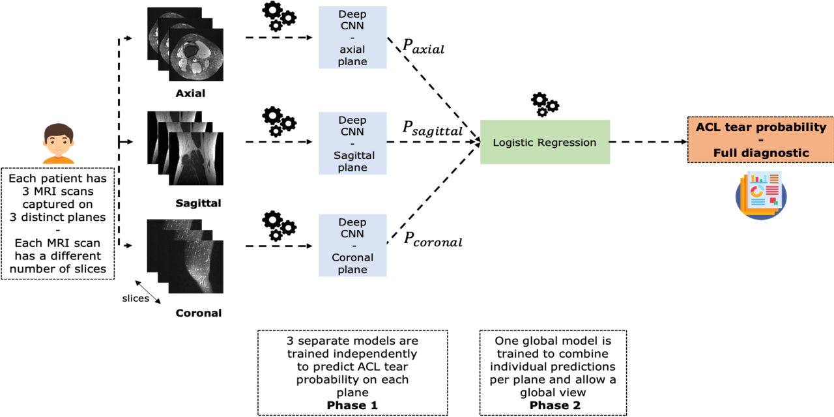
MRNet architecture

Slide 15
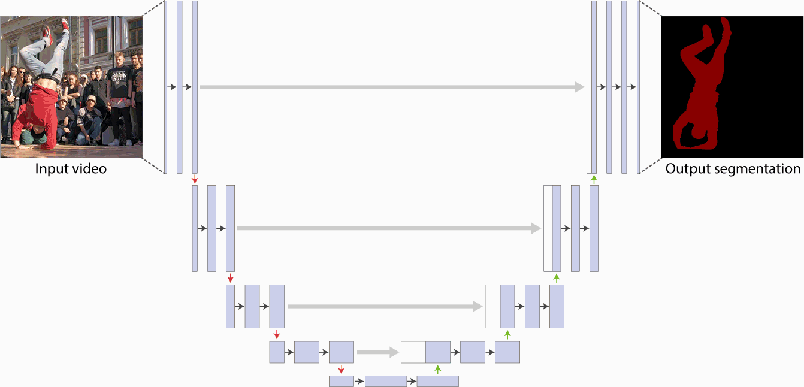
U-Net and V-Net
Were designed by applying similar principles in MRNet to a convolutional neural net work which can segment an ROI from an input two or three-dimensional image.

Slide 16
U-Net vs V-Net
U-Net
Tailored for 2D image segmentation.
Composed of a symmetrical structure resembling a 'U', with a contracting pathway (left) and an expanding pathway (right).
Utilizes residual connections or skip connections.
Typically used for biomedical image segmentation1
V-Net
Tailored for 3D image segmentation, suitable for volumetric medical image analysis.
Similar to U-Net but designed for 3D images.
Does not use batch normalization and utilizes 5x5x5 3D convolutional layers as well as 2x2x2 convolutional layers.
Has 4 concatenations compared to U-Net's
Outperforms most prior arts in volumetric medical image segmentation

Slide 17
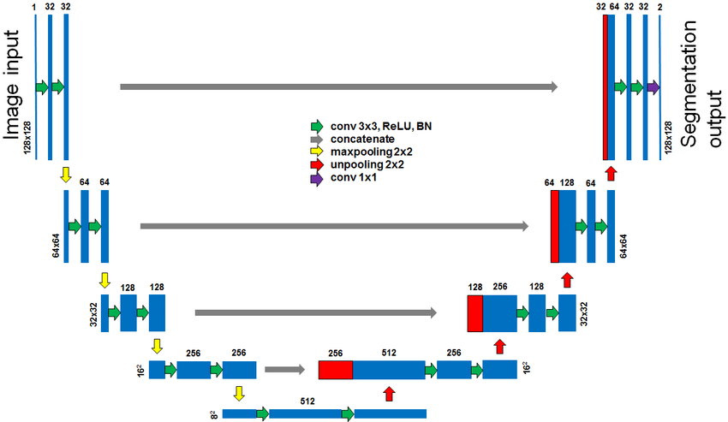
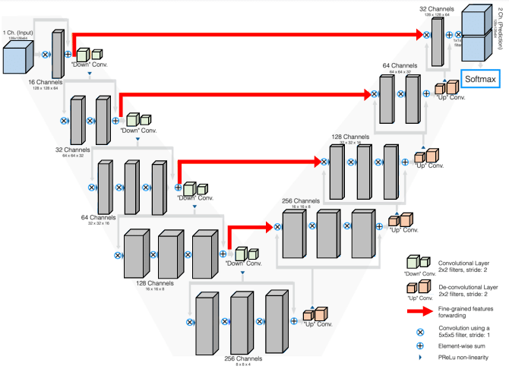
U-Net&V-Net architectures
U-Net
V-Net

Slide 18
LinkNet
architecture similar to U Net, The network allows for learning without any significant increase in the number of trainable/non-trainable parameters.
designed to minimize the total number of parameters the network contains. This allowed segmentation to be performed in real-time..
Holds at least 11.5 million parameters, similar to U-Net, where several encoder and decoder blocks slowly break down an image and rebuild the outcome through a series of final convolutional layers.

Slide 19
Linknet vs u-net
Designed for real-time semantic segmentation.
Utilizes a lightweight encoder-decoder architecture with residual connections.
Employs a novel upsampling module called a decoder, which is designed to reduce the number of parameters and computational complexity.
Achieves high accuracy with fewer parameters and faster inference time compared to other architectures

Slide 20
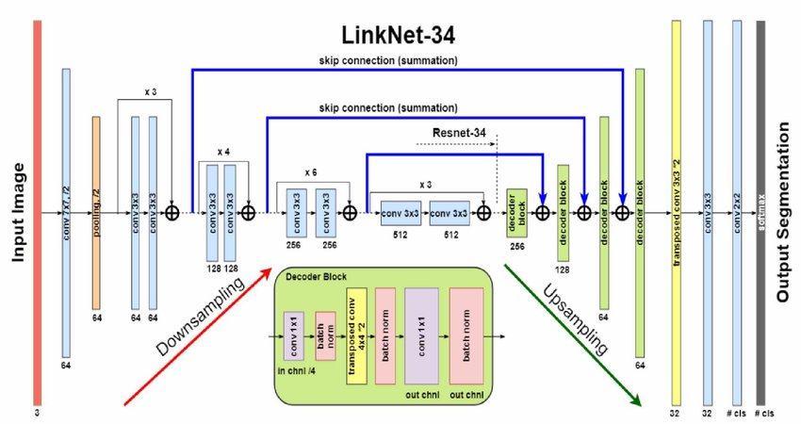
Linknet architecture

Slide 21
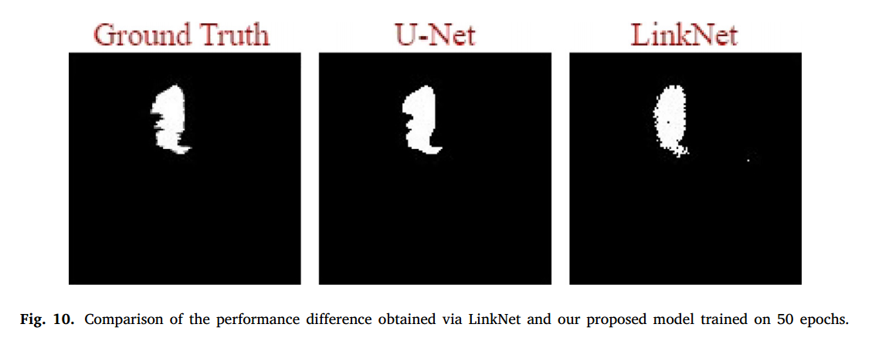
Output of U-net vs link-net

Slide 22
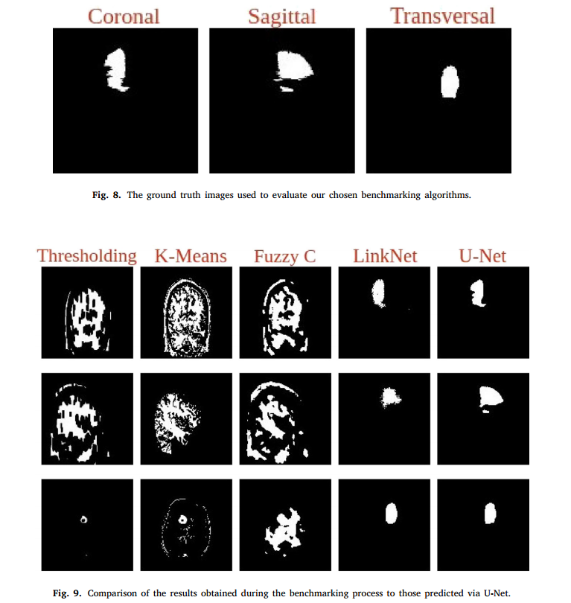
Comparison of other models

Slide 23
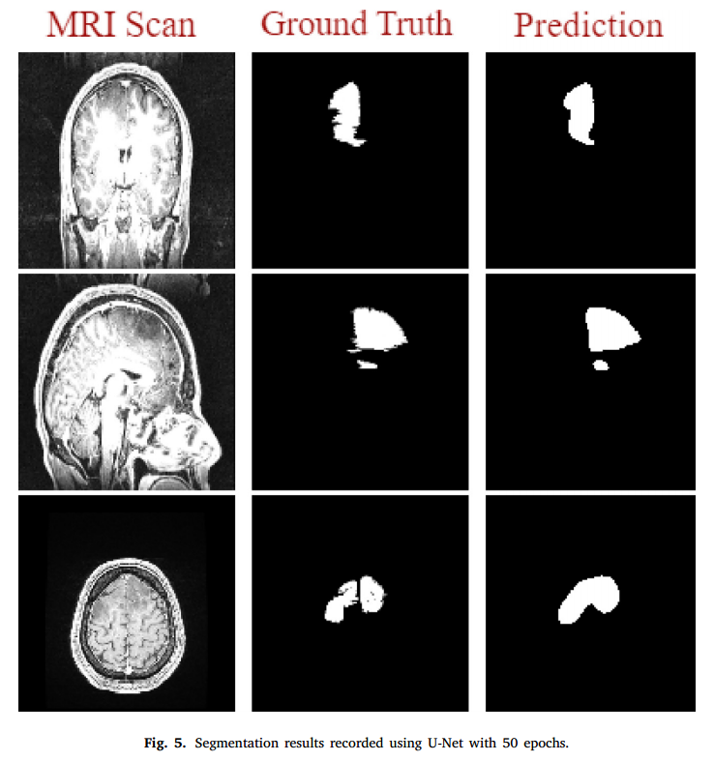
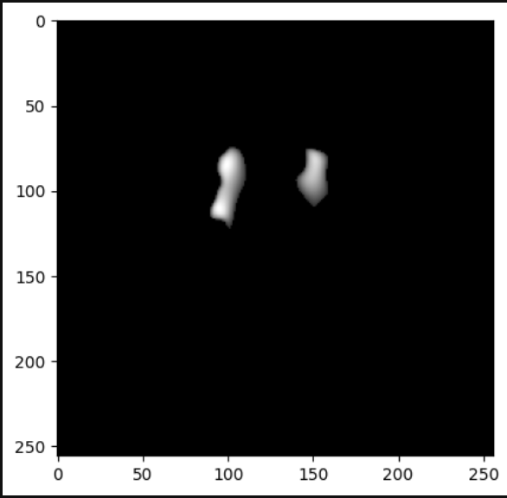
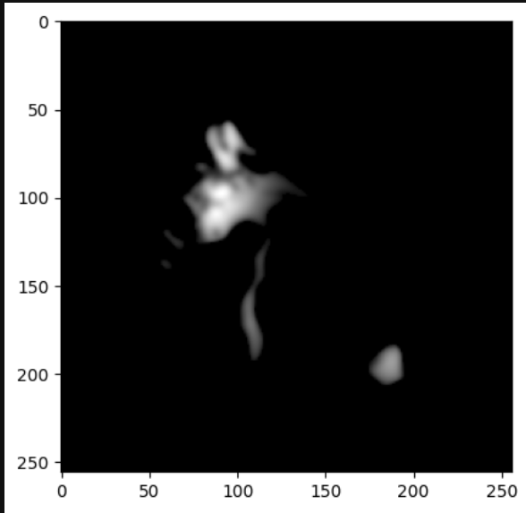
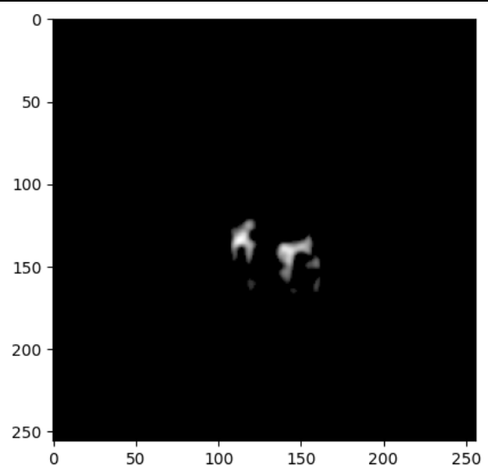
Purposed outcome vs my outcome

Slide 24
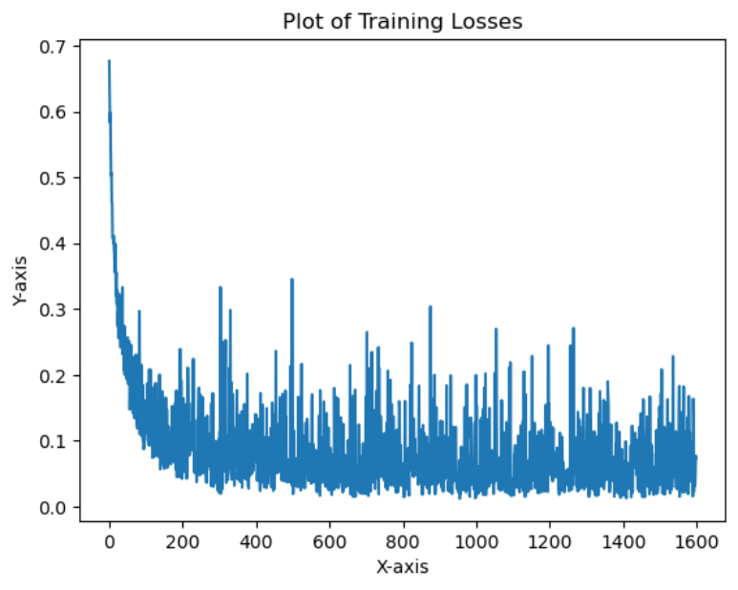
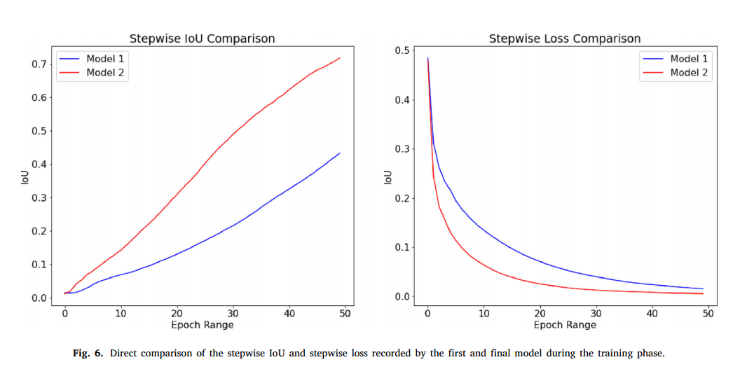
Loss plots

Slide 25
Conclusion
While the deep learning methods perform segmentation task automatically, the other three benchmark algorithms, (Thresholding, K-Means, Fuzzy C-Means) needed more ‘manual’ interference but they perform better when the tumor is clearly distinguishable at the pixel level in terms of intensity and isolation.

Slide 26
Benchmarking Results
U-Net demonstrates superior performance compared to widely used algorithms in brain tumor segmentation.
The proposed lightweight U-Net is accurate and suitable for real-time automatic image segmentation on MRI brain scans.

Slide 27
Conclusion
The lightweight U-Net architecture provides efficient and accurate brain tumor segmentation in MRI images.
U-Net's performance surpasses standard benchmark algorithms, making it a practical solution for real-time automatic image segmentation.

